Slide 1
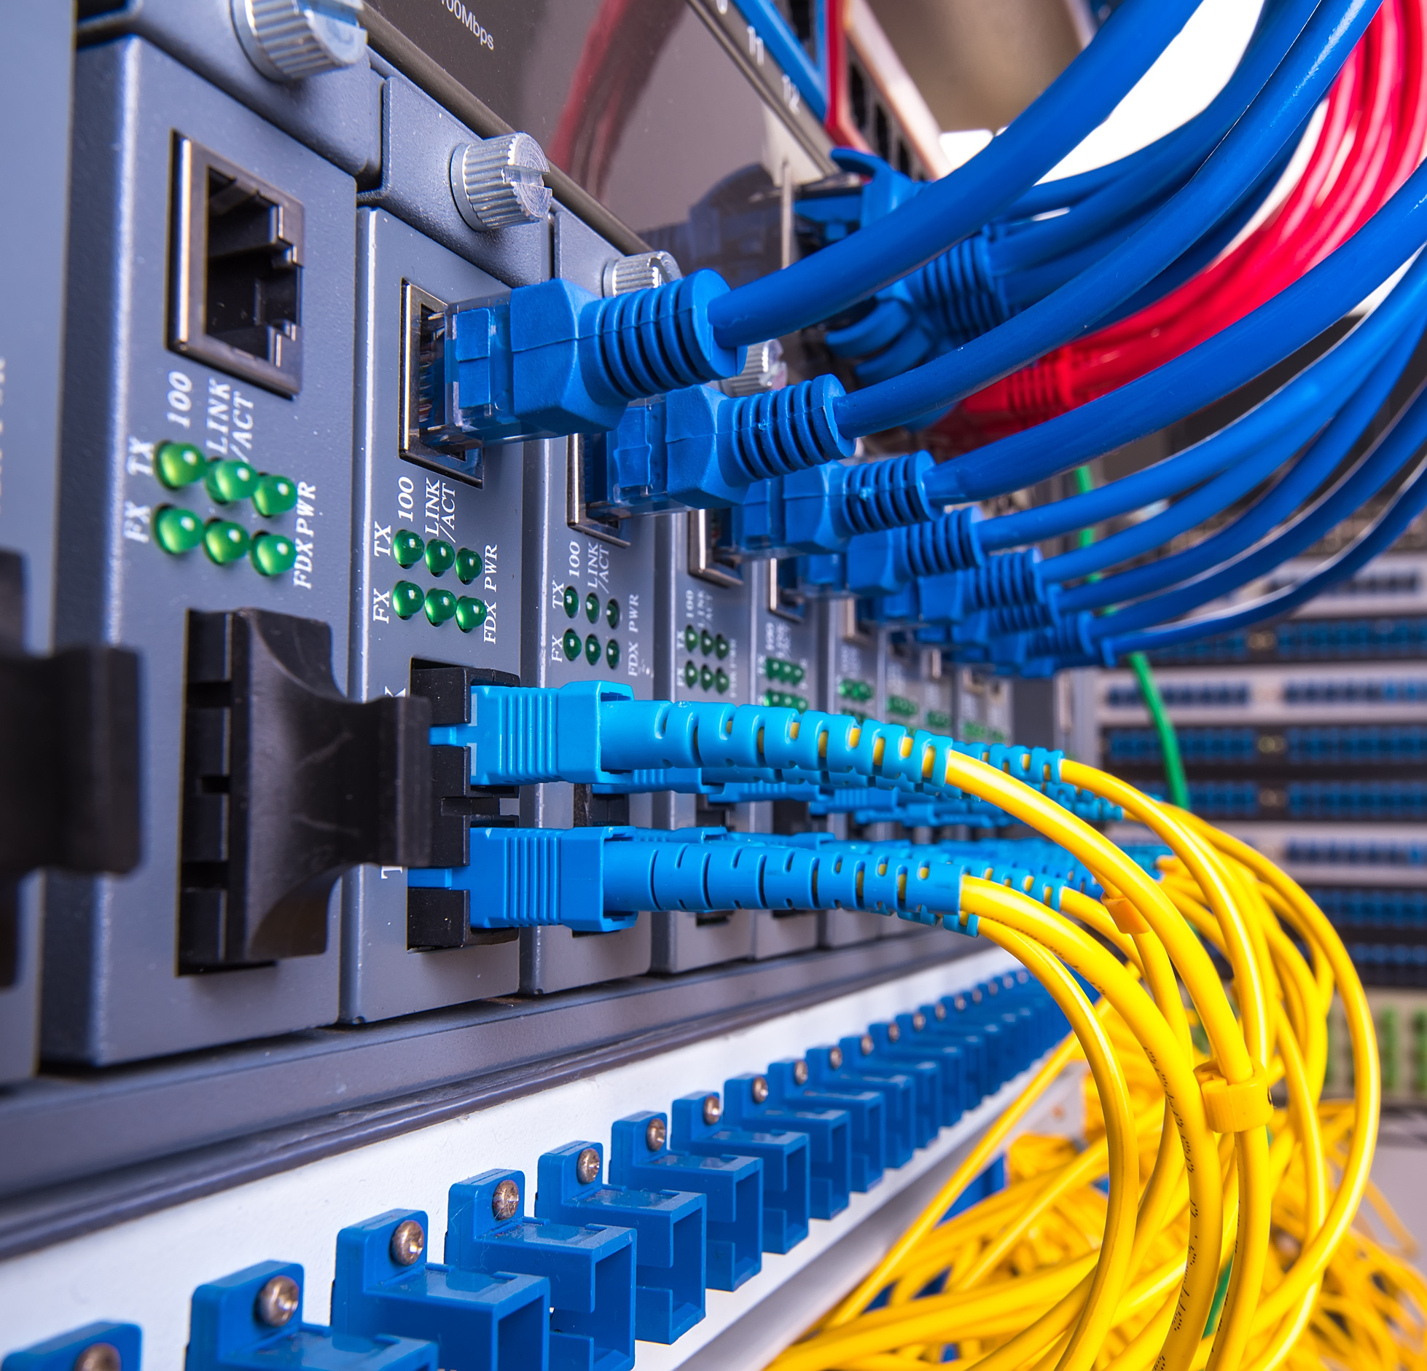
Single Site
Enterprise Network
Notes:
1

Slide 2

Content
1
Project Overview
4
Configuration
2
Project Scope
5
Security
3
Network Topology
6
Services
Notes:
6

Slide 3
Project Overview
Objective
Key Components
Network Design
To design and implement an internal network using Cisco devices, providing a secure and redundant infrastructure.
1 ISP Router
The network design utilizes Cisco Packet Tracer for simulation and visualization of the network configuration.
2 Core MLS Switches (CSW)
2 Distribution Switches (DSW)
4 Access Switches (ASW)
32 PCs, 1 Server
Notes:
2

Slide 4
Project Scope
Project Scope
The project aims to design and establish a robust, secure, and scalable network with redundancy and internet access for a single-site location.
Primary Goals:
Scalable Network Architecture: Create a modular network that accommodates future growth and device expansion.
Reliable Connectivity: Provide stable, high-performance connectivity through redundant links and failover mechanisms.
Secure Access: Utilize VLANs, Port security, Bpdu guard, and Acl.
Inter-VLAN Routing: Facilitate communication between VLANs using Layer 3 devices.
Internet Access: Offer high-speed, secure internet connectivity with redundancy to ensure continuous service.
Network Services: Deploy essential services such as DHCP for dynamic IP addressing, TFTP for file transfers, and Syslog for centralized logging and monitoring.
This network will guarantee reliable, secure, and scalable operations for the organization.
Write your topic
or idea
Write your topic
or idea
Write your topic
or idea

Slide 5
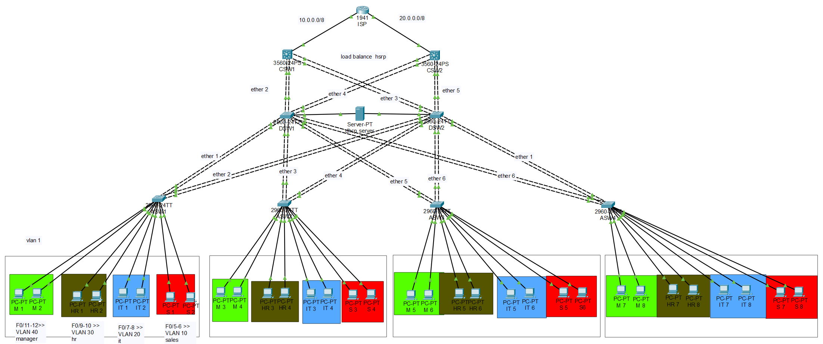
Network Topology
ISP Router
Core Switches
Distribution Switches
Access Switches
Notes:
1

Slide 6
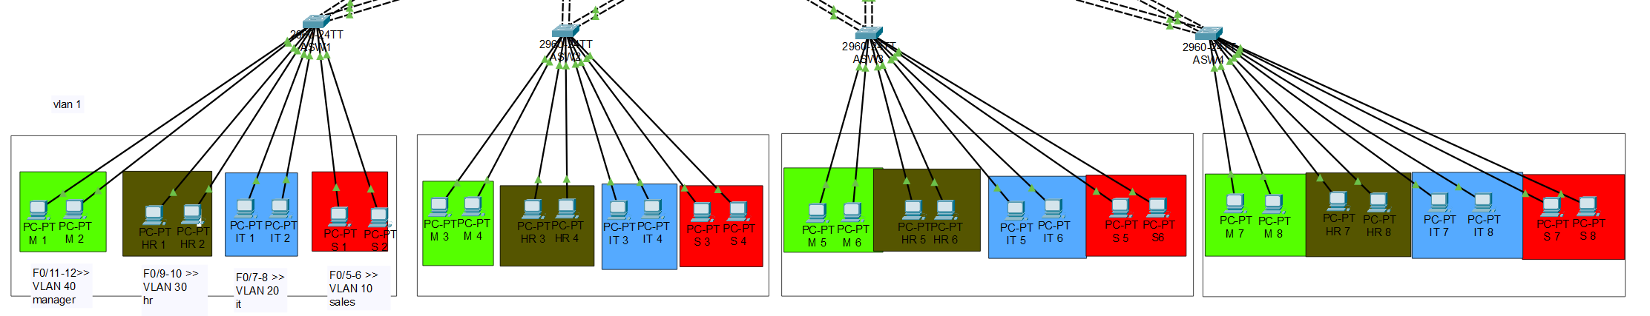
Access Layer
- Connects to individual PCs.
- Provides initial network access.
Notes:
8

Slide 7
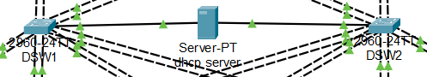
Distribution Layer
- Aggregates traffic from multiple access switches.
- Connects to core switches.
Notes:
8

Slide 8
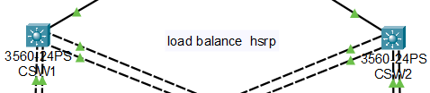
Core Layer
- Provides high-bandwidth connectivity between different network segments.
- Responsible for routing traffic between VLANs and to the internet.
Notes:
8

Slide 9
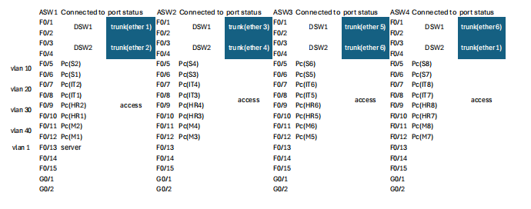
Configuration for Access & Distribution Switches
Access Switch Configuration
Port Assignments
Additional Configurations
Each access switch is configured with VLANs for different departments: Sales (VLAN 10), IT (VLAN 20), HR (VLAN 30), and Managers (VLAN 40). The access switch ports are assigned to their corresponding VLANs.
Specific ports on each access switch are assigned to specific VLANs based on department needs. For example, ports F0/3-4 are assigned to VLAN 10 (Sales).
Trunk ports are configured on the access switches to allow communication between VLANs. EtherChannel is configured using PAgP (Port Aggregation Protocol) for redundancy and increased bandwidth.
Notes:
4

Slide 10
VLAN Trunking Protocol (VTP)
Is a Cisco proprietary protocol used to manage VLANs (Virtual Local Area Networks) within a network. It helps reduce administrative overhead in a large network by allowing VLAN changes to be propagated automatically across all switches in the VTP domain.

Slide 11
VLAN Trunking Protocol (VTP)
Key Concepts:
VTP Domain: A group of switches that share the same VTP settings and configuration.
VTP Modes:
Server Mode: Switches in this mode can create, delete, and modify VLANs, and they propagate this information to other switches in the VTP domain.
Client Mode: Switches receive VLAN information from VTP servers but cannot create, delete, or modify VLANs.
Transparent Mode: Switches do not participate in the VTP process but forward VTP advertisements. VLANs can be configured locally without affecting the rest of the network.
VTP Version: VTP has three versions:
VTPv1 & VTPv2: Used to propagate VLAN information between switches.
VTPv3: Introduces enhancements such as support for extended VLANs (VLAN IDs 1006-4094) and better security.

Slide 12
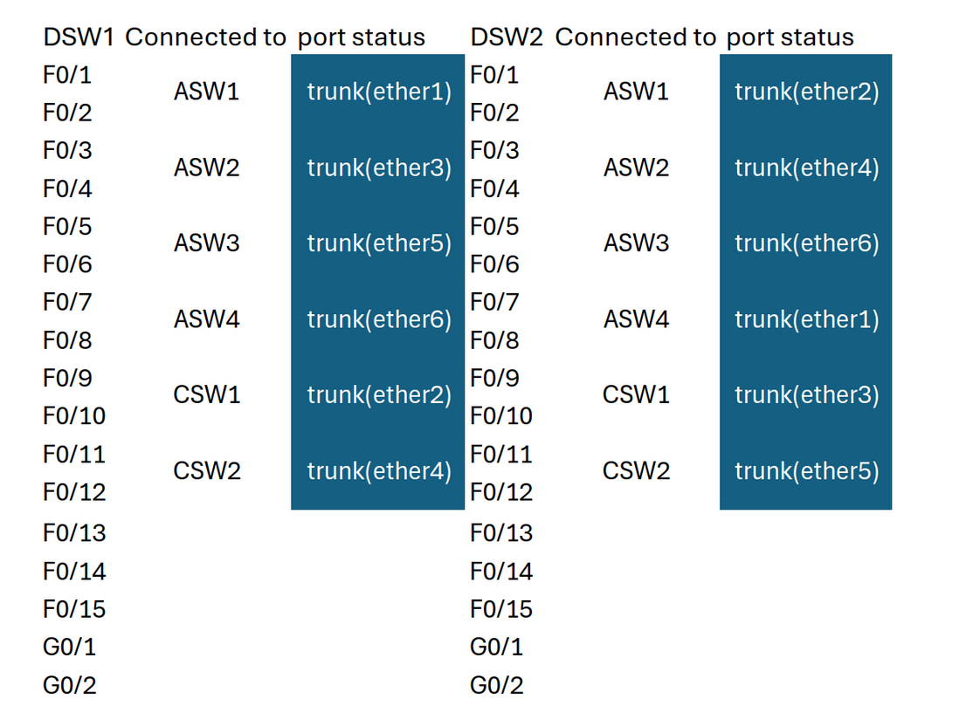
VLAN and Redundancy Setup
DSW 1 and DSW 2 are configured as root bridges for different VLANs to ensure consistent routing and traffic management. This setup also provides redundancy as if one distribution switch fails, the other can take over.
VLAN
Root Bridge
1, 10, 20
DSW 1
30, 40
DSW 2
Notes:
5

Slide 13
Routing & Inter-VLAN Configuration
Active for
interface
vlan 30,40
Active for
interface
vlan 10,20
HSRP Load Balance Between two Core Switches
Multilayer Switches Configuration
Inter-VLAN Routing
HSRP per vlan interfaces Setup
The Multilayer Switch is configured for external connectivity to the internet. Static routes and a default route are established to ensure traffic can reach the internet.
Routing between VLANs is handled by the core switch, allowing for efficient and secure traffic flow between different departments.
HSRP (Hot Standby Router Protocol) provides redundancy for the core. In case of core failure, the other core takes over the active role, ensuring uninterrupted connectivity.
Notes:
8

Slide 14




Security & DHCP Configuration
DHCP Setup
A DHCP (Dynamic Host Configuration Protocol) server is configured to automatically assign IP addresses to devices within each department's VLAN. This eliminates the need for manual configuration, simplifying network management.
Access Control Lists (ACLs)
ACLs are implemented to restrict network access based on specific rules. For instance, the IT department is allowed internet access, while the Sales department is denied access. This provides granular control and enhances network security.
BPDU Guard
BPDU Guard protects network stability by disabling ports that receive unauthorized BPDUs, preventing loops and misconfigurations. When enabled, it puts the port into an error-disabled state if a BPDU is detected, ensuring only authorized devices can participate in the spanning tree protocol.
Notes:
7

Slide 15
Services
Logging Services
Backup Service
Final Deliverables
Routers are configured to send log messages to a centralized log server for analysis and troubleshooting. This provides valuable insights into network activity and helps identify potential issues early.
We used FTP to efficiently back up switch and router configurations to a central server. This ensured quick recovery in case of device failure, allowing us to restore settings with minimal downtime.
The project delivers a comprehensive network configuration with full redundancy, including secure VLAN segmentation, inter-VLAN routing, port security, and ACLs.
Notes:
8

Slide 16




Meet The Team
Abdullah Elbosaty
Mohammed Alaa
Ahmed Galal
Amira Taha
Supervised by
Eng: Mohammed Nasr

Slide 17
Thank you

